Slide 1

Physical Layer: Intro
Computer Network Fundamentals
George Varghese - Fall 2024 (with help from Omar Elamri)
Lecture 2

Slide 2
Worksheet 1 Solution
TCP Set Bit IP
TCP
IP
IP Set Bit TCP

Slide 3
How do we send bits over a wire?

Slide 4
The Foundation: Sending Bits
A three-step process:
Take an input stream of bits
Modulate it to travel over physical media
Demodulate to retrieve bits
Digital
Analog
Digital

Slide 5
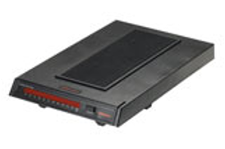

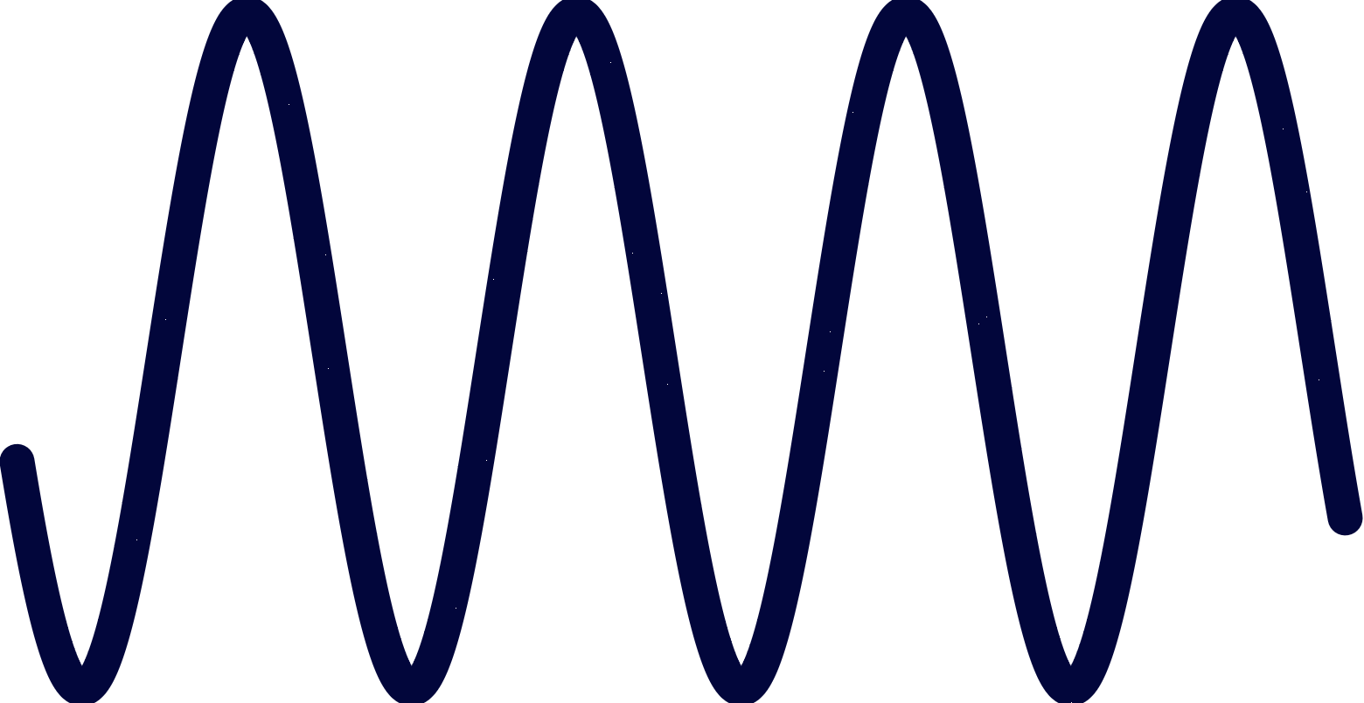
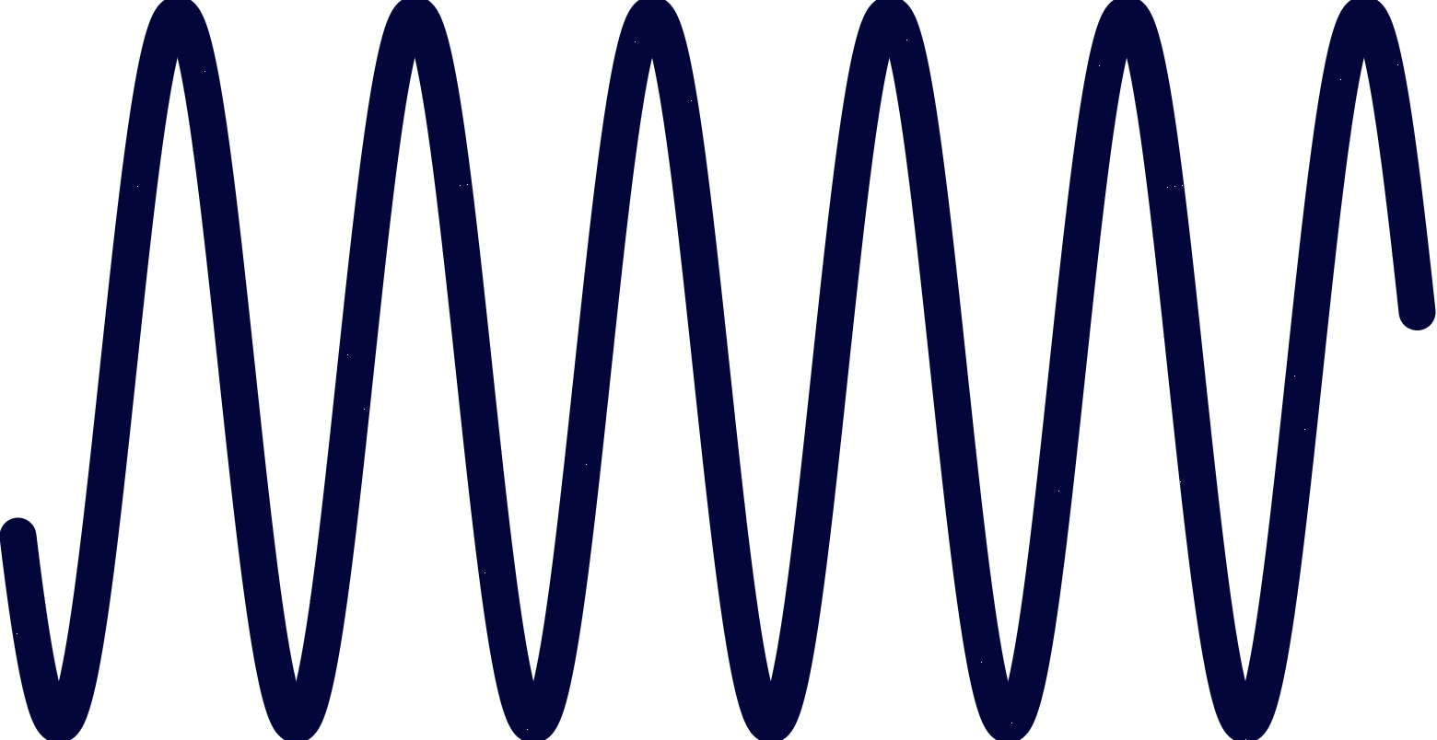
The Foundation: Sending Bits
Anybody heard of a modem (modulator-demodulator)?
signal
010101010101010
010101010101010
Modulation
Demodulation
Digital
Analog (energy that can travel)
Digital

Slide 6
What does the physical layer do, abstractly?
The physical layer is: a possibly faulty, single-hop, bit pipe that connects a sender to possibly multiple receivers.
Recv. 1
010101010101010
Sender
Physical Layer
Recv. 2
…
Recv. n

Slide 7
Morse Code Analogy
Let’s take an example bit pipe: sending Morse Code to receivers using a flashlight.
Fundamental Limits
Media Issues
Coding
Brain-eye system processing limits leads to Inter-Symbol Interference
Flashlight, Semaphore
Morse Code, getting in sync, knowing receiver’s rate

Slide 8
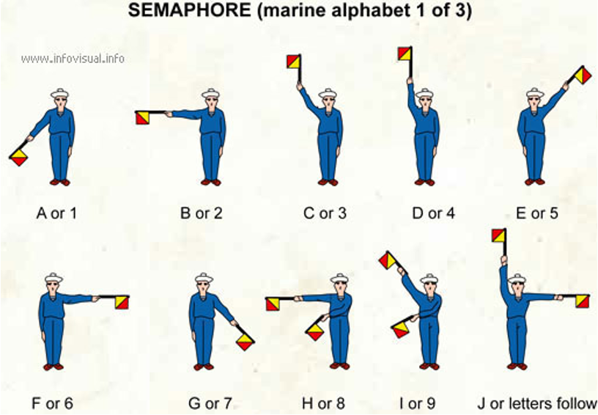
Signaling with Semaphores

Slide 9
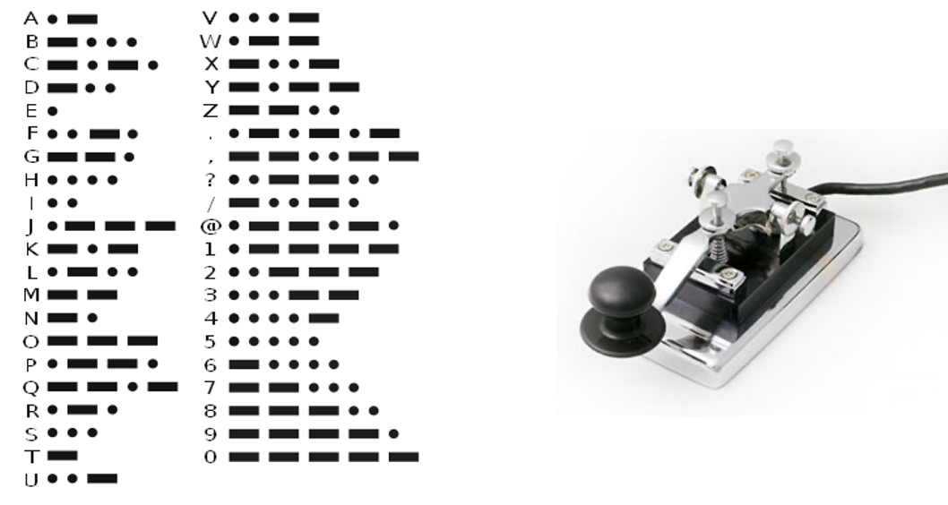
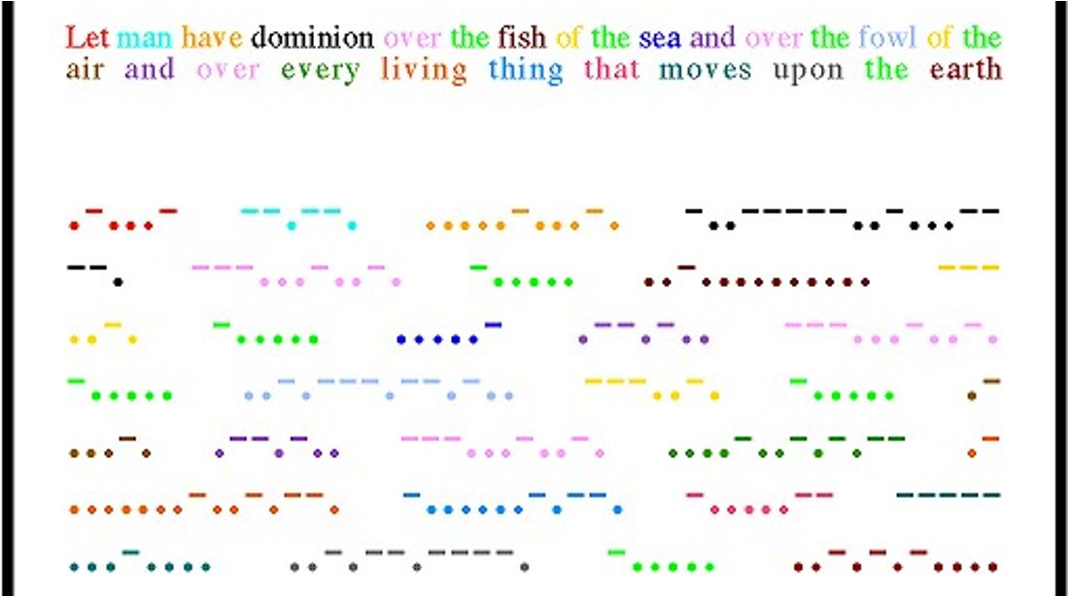
Morse Code Transmission

Slide 10
Physical Layer: Sublayers
010101010101010
010101010101010
Input Stream
Output Stream
Coding
Decoding
Coded Stream
Coded Stream
Modulation
Media Transmission
Media Reception
Demodulation
Input Signal
Output Signal
Signal Transmission
(Nyquist and Shannon limits)

Slide 11
Why understand the sublayers?
Sublayers can be studied independently with separate concerns. Each sublayer exacts its price!
Top Sublayer How senders and receivers synchronize to sample analog signals to bits
Middle Sublayer Properties of particular media — e.g. satellites, coaxial cable, fiber
Bottom Sublayer Essential properties of the media (bandwidth, noise) These influence data transmission rates (Nyquist, Shannon limits)

Slide 12
1.0 Bottom Sublayer: Signal Transmission and Limits
How fast can you send? What prevents you from sending faster?

Slide 13
Sending bits to a receiver
Goal: To send a sequence of 0’s and 1’s from a sender to a receiver by sending energy (e.g. light, electricity) over a channel (e.g. fiber, cable). One coding: 0 = no energy, 1 = energy.
Problem: Real channels distort input energy signals. This leads to two main questions.

Slide 14
Sending bits to a receiver
How do we predict output of energy on channel?
How does distortion affect maximum bit rate?
Answer: Fourier Analysis
Answer: Nyquist (sluggishness) and Shannon (noise) limits

Slide 15
Fourier Analysis: The Big Picture
If we forget about noise, most channels are “nice” to sine waves.
A wave of frequency f is always:
scaled by a fixed factor a( f ) (amplitude response), and
shifted by a fixed amount p( f ) (phase response).
We can completely describe a channel by plotting these two functions for all frequencies f.

Slide 16
Fourier Analysis: The Big Picture
To find out what happens to an arbitrary signal S, we:
use Fourier Analysis to rewrite S as a sum of sine waves with different frequencies,
use the amplitude and phase response to see the effect of each sine wave, and
add the scaled sine waves to find the output signal.
We won’t study this except to motivate the idea of bandwidth and to state its use in understanding the Nyquist limit.

Slide 17
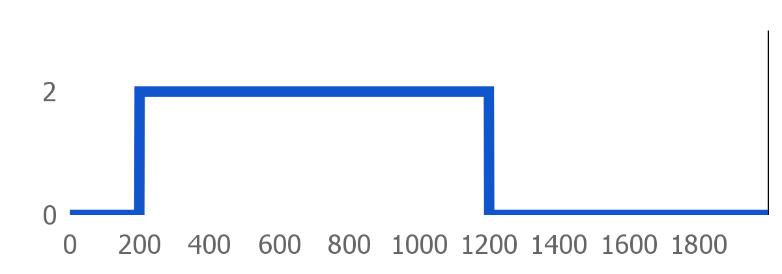
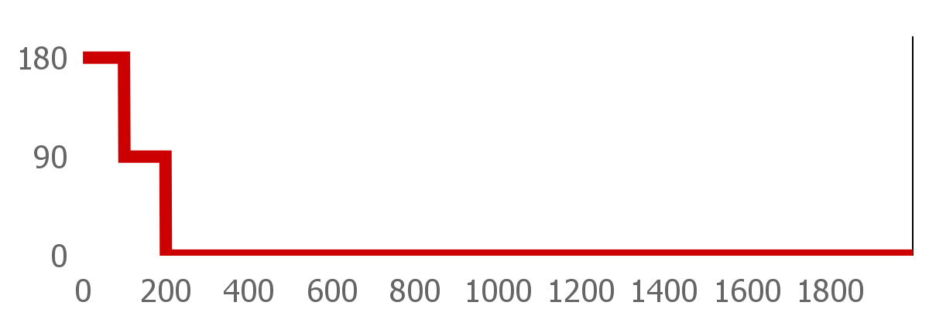
Amplitude and Phase Response Example
Scaling Factor (Amplitude Response)
Definitions of Bandwidth:
EE: The range of frequencies for which a channel passes signal through (not very precise).
CS: How fast is my cable modem in bits/s?
These two notions of bandwidth connect with the Nyquist limit.
Phase Shift (Phase Response)
Frequency (Hz)

Slide 18
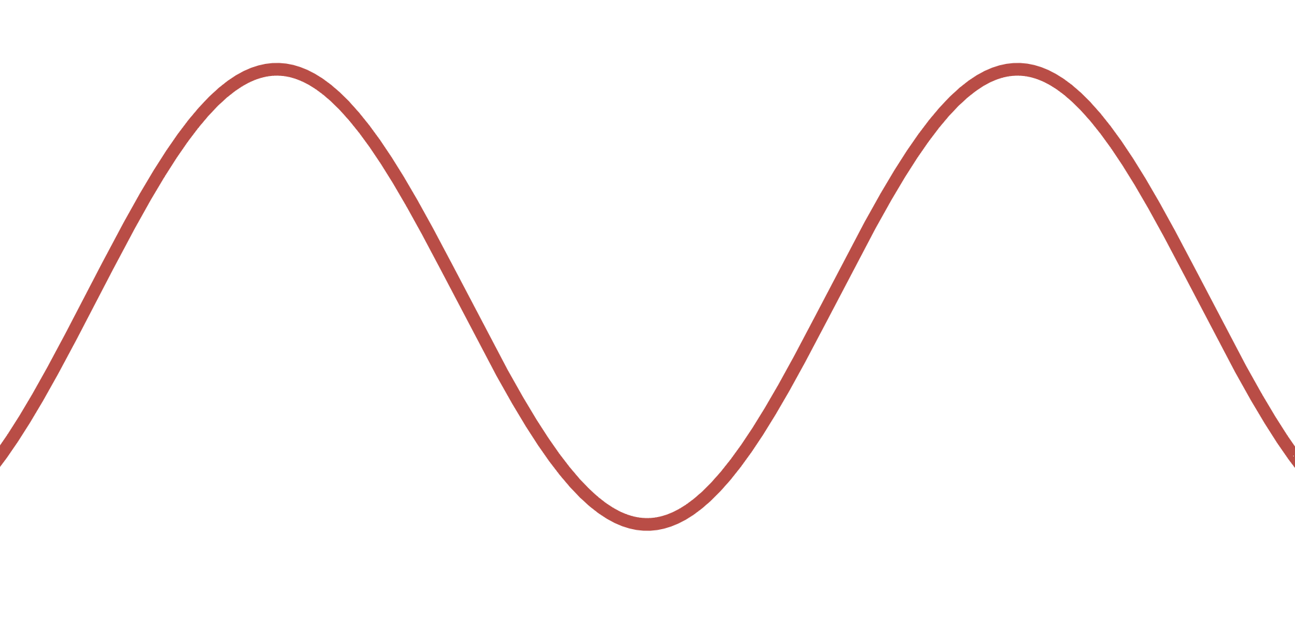
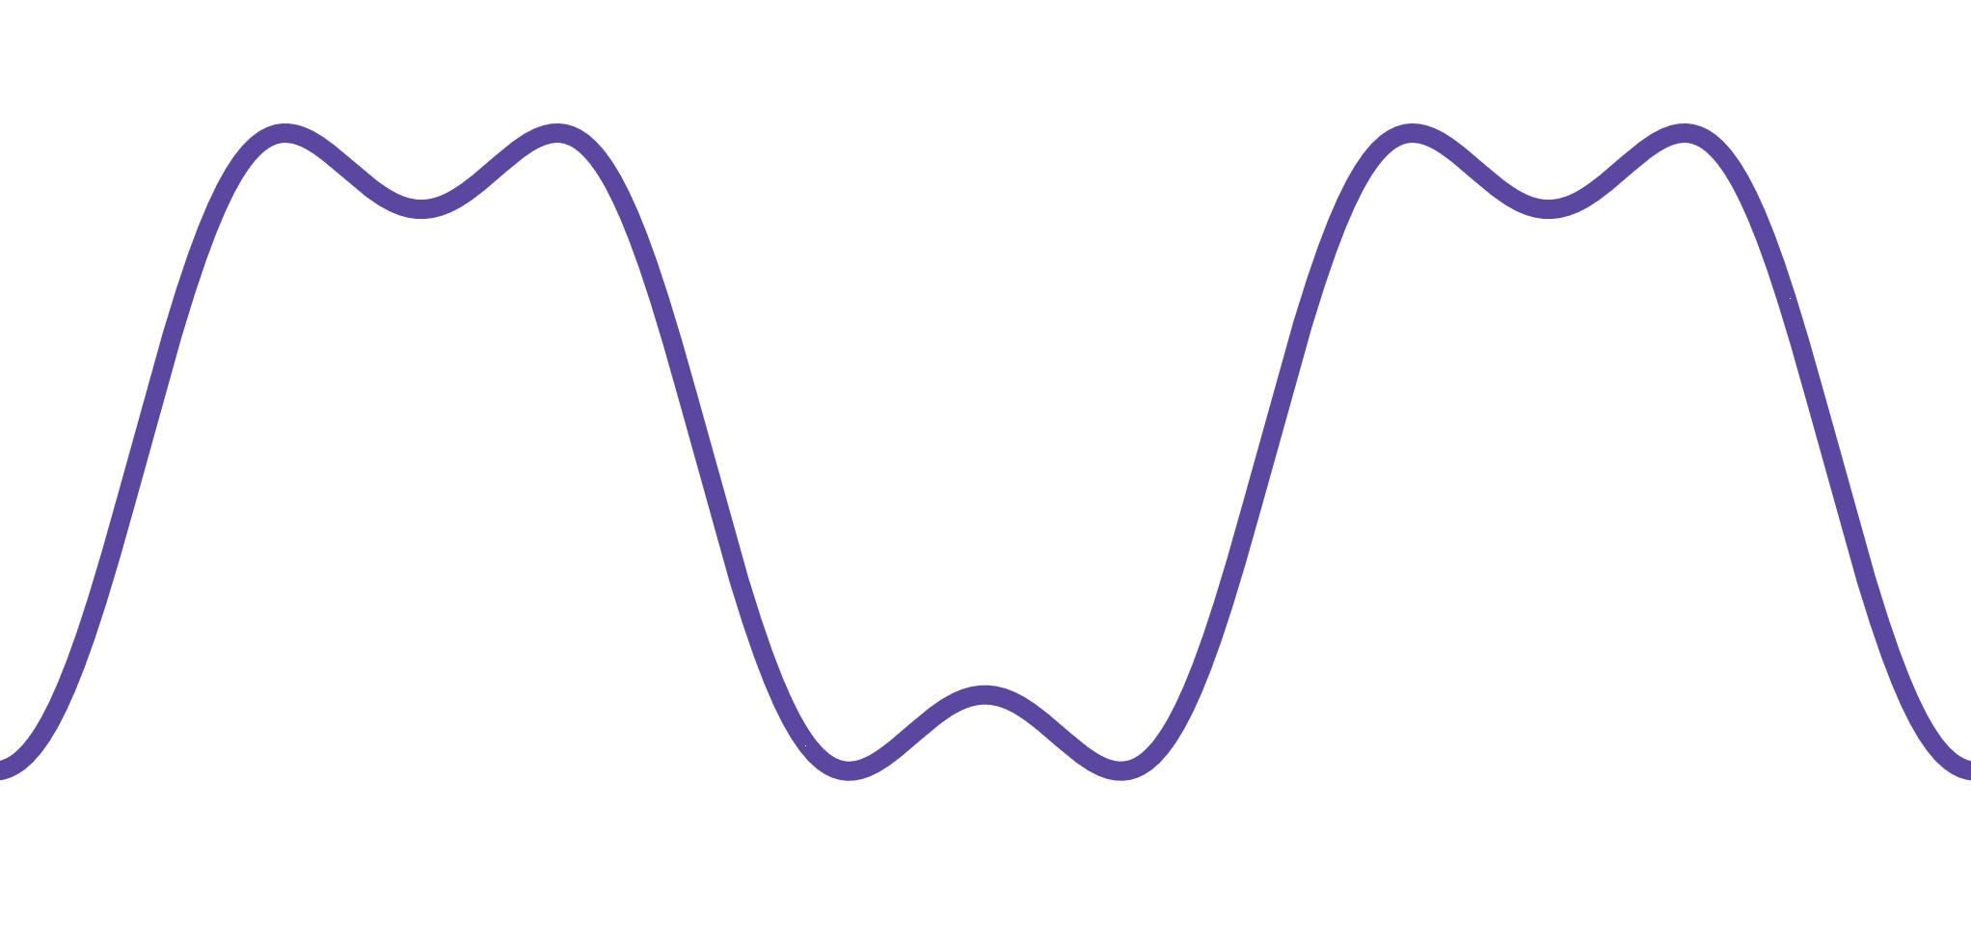
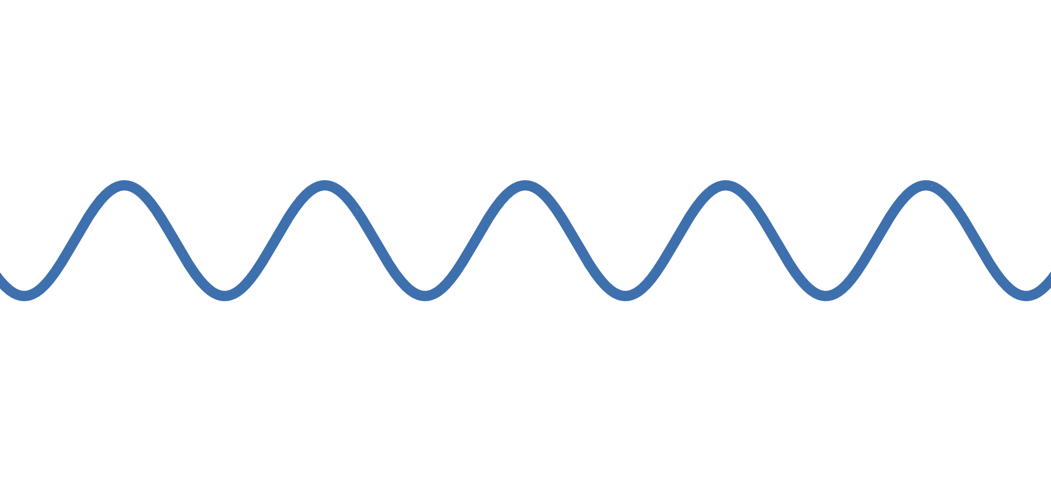
More bandwidth, more fidelity
sin(x)
+
=
sin(x) + 0.3sin(3x)
0.3sin(3x)

Slide 19
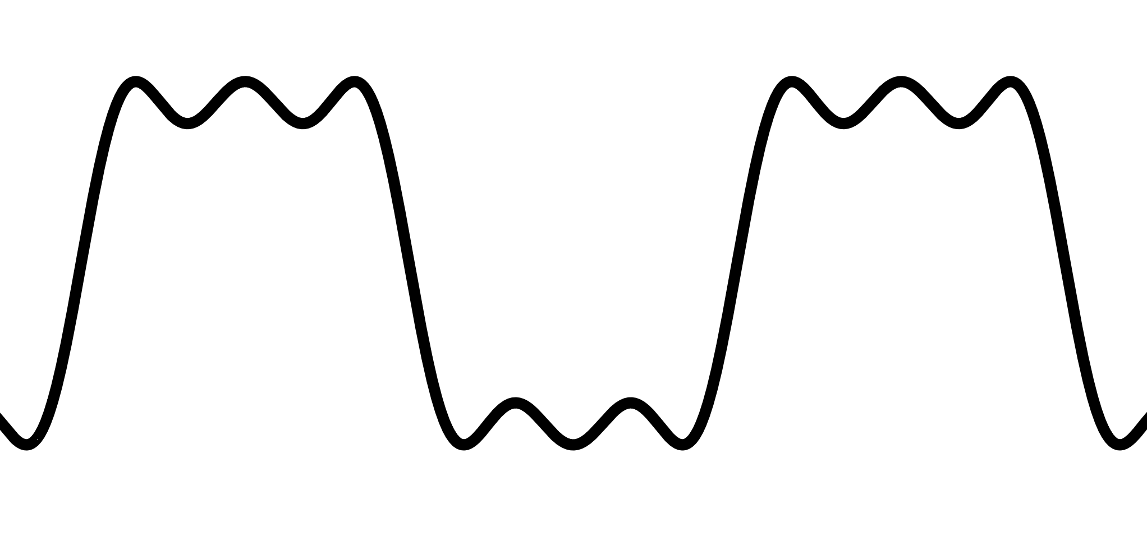
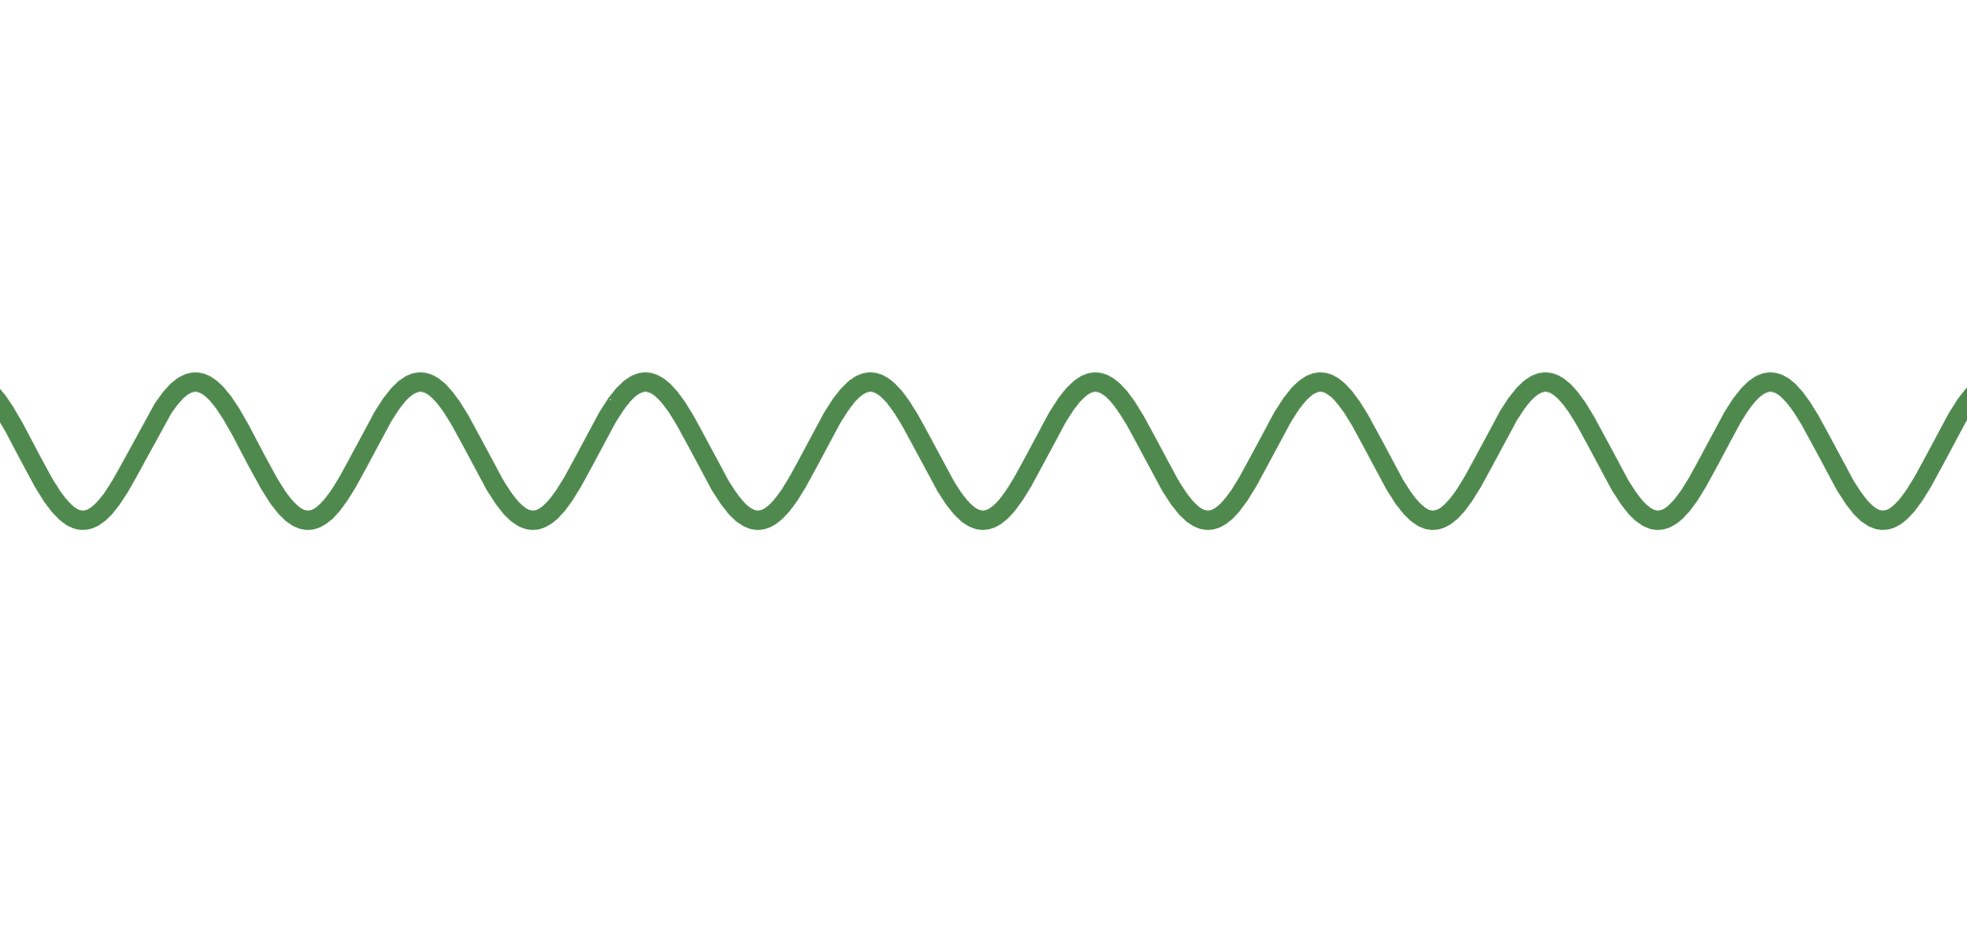
More bandwidth, more fidelity
sin(x) + 0.3sin(3x)
+
=
sin(x) + 0.3sin(3x) + 0.2sin(5x)
0.2sin(5x)

Slide 20





More bandwidth, better recovery of bits
Original Signal
Fourier Analysis
0 1 1 0 0 1 0 0 0 0
RMS Amplitude
1 2 3 4 5 6 7 8 9 10 11 12 13 14 15
Harmonic number
Reconstruction with 1 harmonic
1
Reconstruction with 2 harmonics
1 2
Reconstruction with 4 harmonics
1 2 3 4

Slide 21
Sluggishness and Noise
Most channels are sluggish (they take time to respond) since they turn a deaf ear to higher frequencies in the input signal. Thus, lower bandwidth channels are more sluggish.
What about noise? There are different models for different channels, but the simplest and most common model is white noise:
Uniformly distributed within all frequencies
Normally distributed within a specific frequency

Slide 22
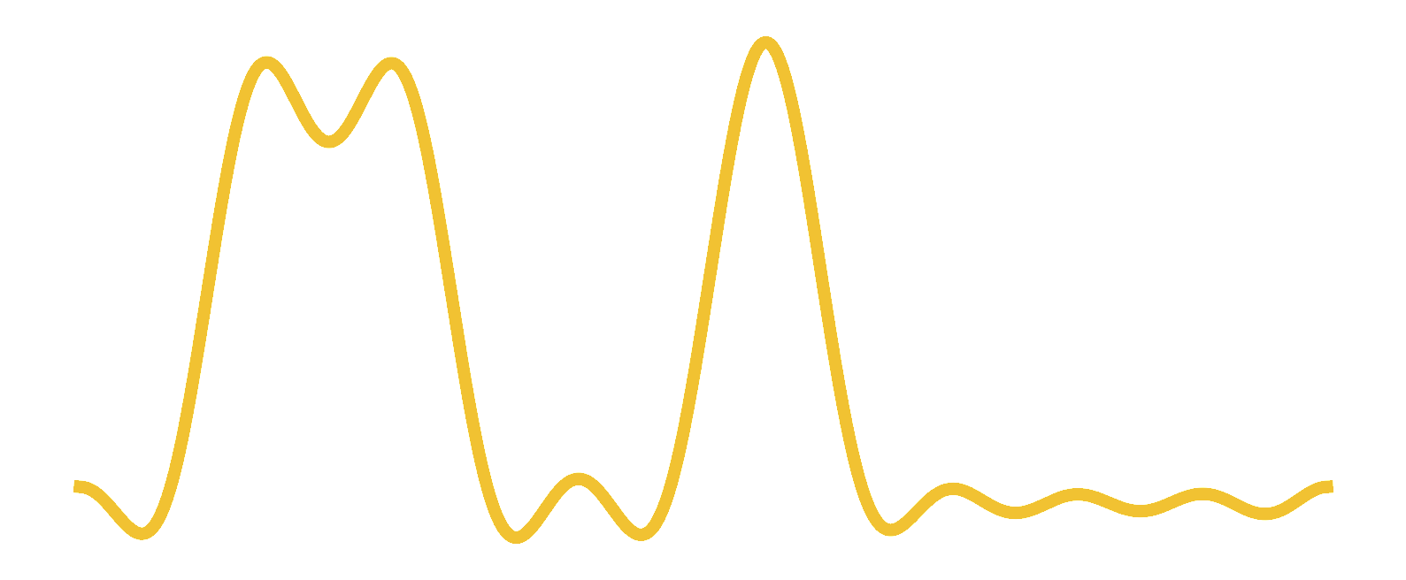
Sampling Bits
Receivers recover the bits in the input signal by sampling the output signal close to the middle of bit periods.
Two limits to bit rate:
Channel bandwidth (Nyquist)
Noise (Shannon)
0 1 1 0 0 1 0
Input
Output
Ideal sampling points at receiver

Slide 23
1.1 Nyquist Limit
Why how fast you can send (CS bandwidth) depends on the range of frequencies a channel can pass (EE bandwidth)

Slide 24



Amplitude Response
0
1/T
Bandwidth
Sender
Receiver
Input
Output (sinc)
0
T
0
T
Period
Period

Slide 25
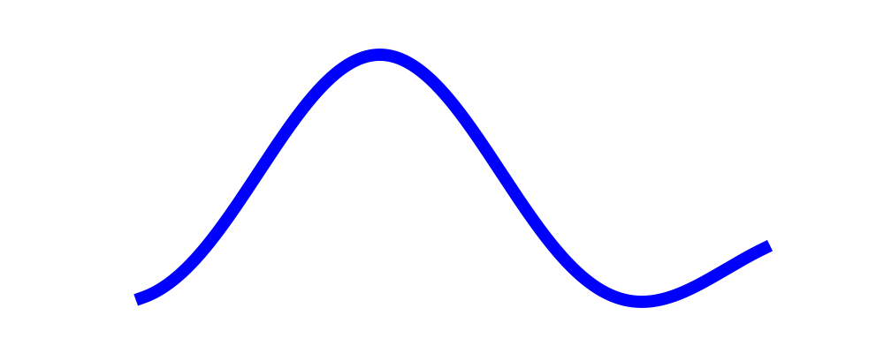
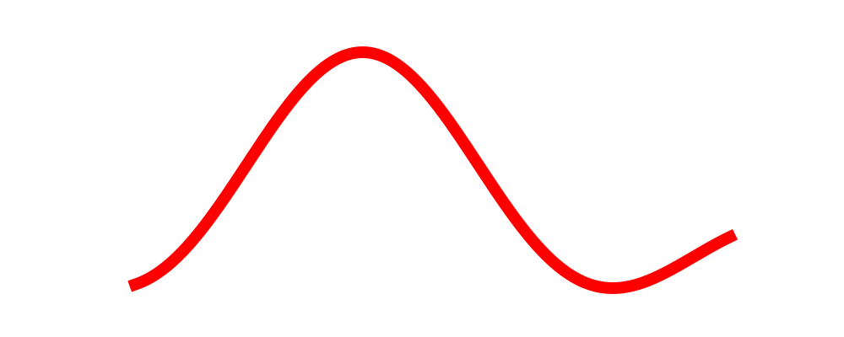

How fast can we send without Intersymbol Interference?
Clearly, sending every T works

Slide 26
How fast can we send without Intersymbol Interference?
Bandwidth: 1/T = B
Max Bit Rate (Nyquist rate): 2×1/T = 2B
Nyquist noticed that sending every T/2 also works because the “peaks” line up with the past “zeroes”

Slide 27
1.2 Shannon Limit
Why how fast you can send depends on noise and bandwidth

Slide 28
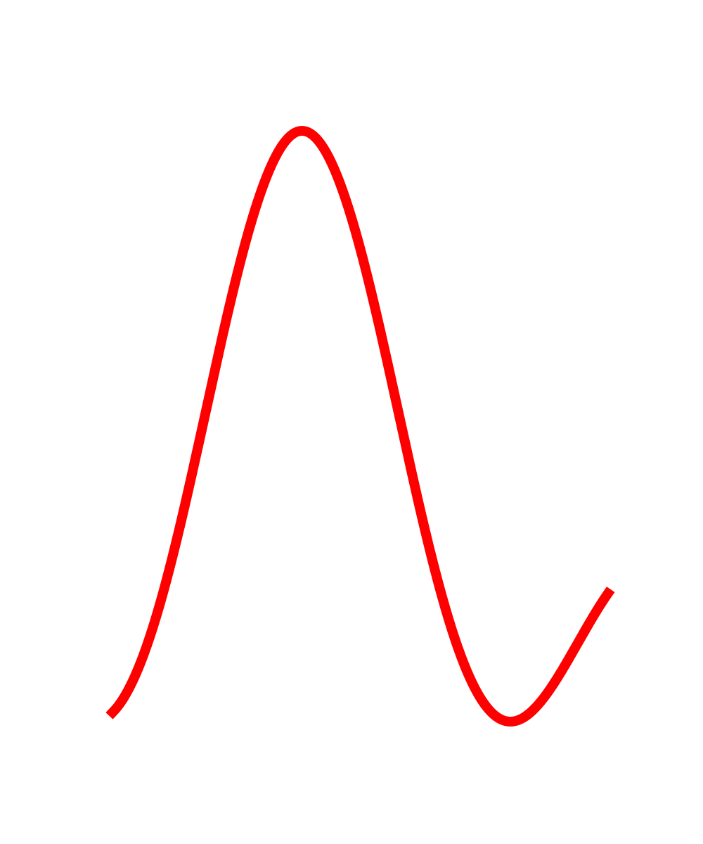
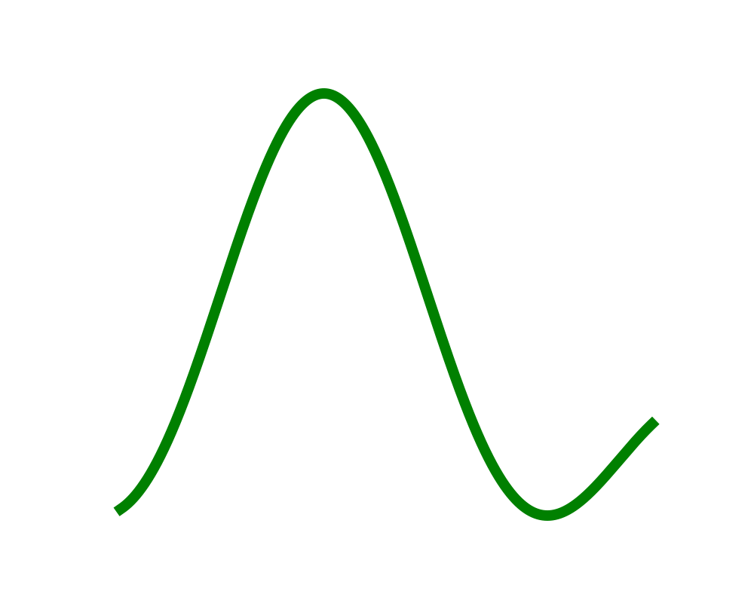
6V
4V
2V
Output: 01
Output: 10
Output: 11

Slide 29
Baud and Bit Rate
To prevent ISI, we cannot send symbols faster than 2B times per second; the Nyquist rate is the max rate of sending symbols not bits (baud rate).
However, we saw each symbol in a signal carry multiple bits: 0V, 2V, 4V, and 6V; 4 possible values and 2 bits per symbol.
With L signal levels, the bit rate is log L × 2B.
Why can’t we send terabits at a time? Noise will make one output level look like a nearby one.

Slide 30
Noise can pull up
Noise can pull down
6V
4V
Output: 10
Output: 11
How much noise can we tolerate?

Slide 31
The Shannon Bound
S
S: Maximum Signal Amplitude
N: Maximum Noise Amplitude
log(S/2N) bits/signal
2B signals/sec (Nyquist)
Naive Bound: log(S/2N)× 2B
Shannon Bound: log(1 + S/2N)× B
Level 5
N
Level 4
Level 3
Level 2
Level 1

Slide 32
The Shannon Bound
The real Shannon bound log(1 + S/2N)× B is slightly different than the naive bound log(S/2N)× 2B since our simple model was only for a simple coding and for fixed deterministic noise.
The Shannon bound works for any coding scheme (frequency, phase modulation) and for Gaussian additive noise; needs a deep probabilistic argument.
For example, a telephone line (not DSL) with
a signal-to-noise ratio of 30 dB and
bandwidth of 3 kHz,
we get a maximum data rate of 30 kbps.

Slide 33
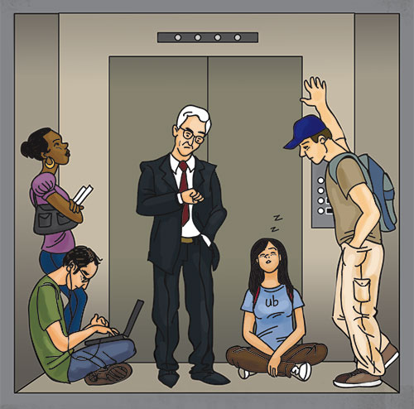
Prize Question 1
Slow Elevator Problem: How can we deal with this more cheaply than buying a new elevator?

Slide 34
2.0 Top Sublayer: Clock Recovery
How does a receiver know when to sample bits, and how can the sender help?

Slide 35
Who needs a clock anyway?
How can we initially sync the sender clock with the receiver clock? Initial Training Bits
Problem: All real physical clocks drift over time, which is crucial at high speeds. Small drift leads to sampling errors. How do we keep in sync? Transitions
1 1 0 0 1 1 0 0 1 1
1 0 1 0 1

Slide 36
Transitions and Coding
How can we parse this: “nohewontgosoon?” Clearly, we need spaces and punctuation to parse speech.
A stream of bits without transitions (change in signal value) is equally hard to parse.
Real data may contain all 0s. How can we ensure transitions? Coding However, this adds cost.
We can code to ensure that every n bits you get at least m transitions. There are different coding schemes parameterized by n and m.

Slide 37
Asynchronous Coding
Codes a character (5-7 bits) at a time (ASCII with parity bit).
Characters are framed using a start bit and one or two stop bits. 1 is encoded as low voltage 0 is encoded as high voltage
Start Bit
1-2 Stop Bits
5-8 data bits + parity
Ideal Sampling Points

Slide 38
Receiver Code
Data Structures
C[0..10]; ARRAY, to store bits in current character
On Transition
StartTimer (½ bit);
For (i = 0 to 10) do
Wait (TimerExpiry);
C[i] = SampleSignal;
StartTimer (1 bit);
End;
If (C[0] = 1) and (C[9] = C[10] = 0) then Output C[1..8]

Slide 39
Prize Question 2
Slow Clock Problem: How much slower can the receiver clock be without any problems?

Slide 40
Physical Layer: More Clock Recovery, Modulation, Media
Computer Network Fundamentals
George Varghese - Fall 2024
Lecture 3

Slide 41
Making it real: More sophisticated clock recovery and types of media

Slide 42
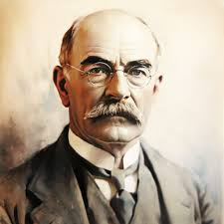
LECTURE 2 EPILOG: KIPLING ON VALUES
Many years ago Rudyard Kipling gave an address at McGill University in Montreal. He said one striking thing which deserves to be remembered. Warning the students against an over-concern for money, or position, or glory, he said: “Some day you will meet a man who cares for none of these things. Then you will know how poor you are.”
― Guy Kawasaki, The Art of the Start: The Time-Tested, Battle-Hardened Guide for Anyone Starting Anything

